Slide 1

With ULX3S
Presented by Miodrag Milanovic and Jan Dolinaj

Slide 2

Who we are ?
Engineers
Hardware enthusiasts
Software developers
Very interested in FPGA
Working with Symbiotic EDA on NextPnR, Yosys, …

Slide 3

ULX3S

Slide 4

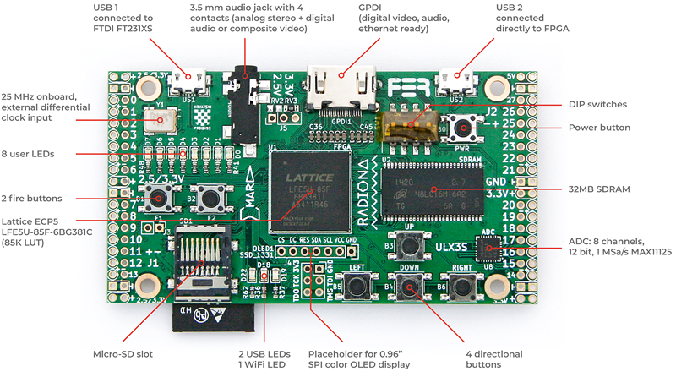
ULX3S - Top

Slide 5
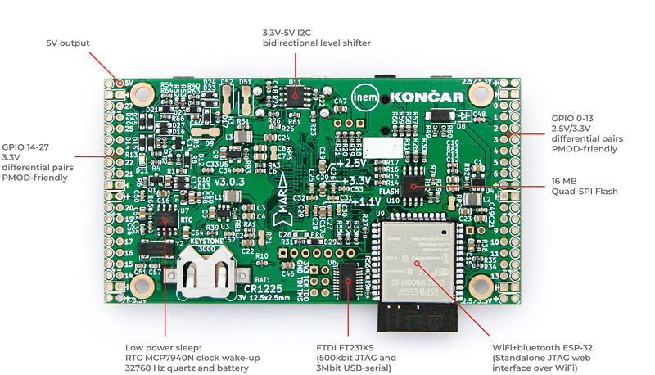
ULX3S-Bottom

Slide 6
FPGA

Slide 7
What is FPGA ?
Field-programmable gate array
Logic block – LUT + D Flip-Flop + full adder
I/O block – one per each pin
Interconnections, clock tree
Hard block – Block RAM, multipliers, DSP, CPU,…
Vendors: Xilinx, Intel/Altera, Lattice, Microsemi, Anlogic,
AGM, GoWin …

Slide 8
Logic block
Carry in
LUT
Full
Adder
D
Flip-Flop
MUX
Input
MUX
Output
MUX
Carry out
Clock

Slide 9

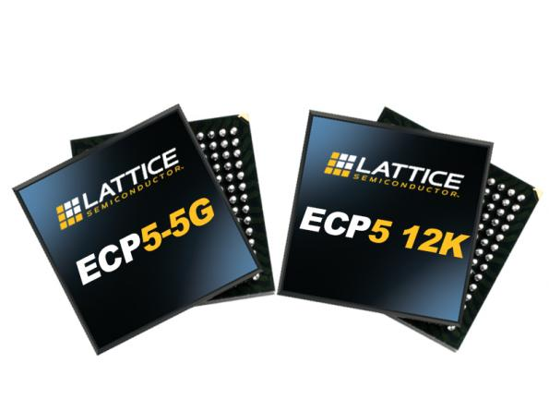
Lattice ECP5
Affordable price
From 12K to 85K
5G SERDES
Open source toolchain
Lot of nice boards available

Slide 10
TOOLS

Slide 11
How do we program FPGA ?
HDL - Hardware description language
VHDL and Verilog
Analysis: parsing and validation of HDL
Synthesis: HDL -> netlist
Place-and-route: netlist -> specific FPGA technology
Assembler: specific FPGA technology -> bitstream
Programming: deploying bitstream on device (serial flash memory or SRAM)
Timing analysis
Simulation

Slide 12
Open source tools
Yosys - Verilog synthesis tool by Clifford Wolf
NextPnR - Place and route tool by Symbiotic EDA team
Project Trellis – Documenting the Lattice ECP5 bit-stream format by David Shah
APIO – micro-ecosystem for open FPGAs by Jesús Arroyo Torrens and Juan González (Obijuan)

Slide 13
And more …
Arachne PnR - Place and route tool by Cotton Seed (ICE40)
Project IceStorm – Assembler, time analysis and FPGA programming tool by Clifford Wolf and Mathias Lasser (ICE40)
Icestudio - graphic editor for open FPGAs by Jesús Arroyo Torrens
Icarus Verilog by Stephen Williams
Verilator by Wilson Snyder with Duane Galbi and Paul Wasson
FuseSoC - package manager and a set of build tools for FPGA/ASIC development by Olof Kindgren

Slide 14

YOSYS
This is a framework for RTL synthesis tools. It currently has extensive Verilog-2005 support and provides a basic set of synthesis algorithms for various application domains.
Yosys can be adapted to perform any synthesis job by combining the existing passes (algorithms) using synthesis scripts and adding additional passes as needed by extending the yosys C++ code base.
Yosys is free software licensed under the ISC license (a GPL compatible license that is similar in terms to the MIT license or the 2-clause BSD license).

Slide 15
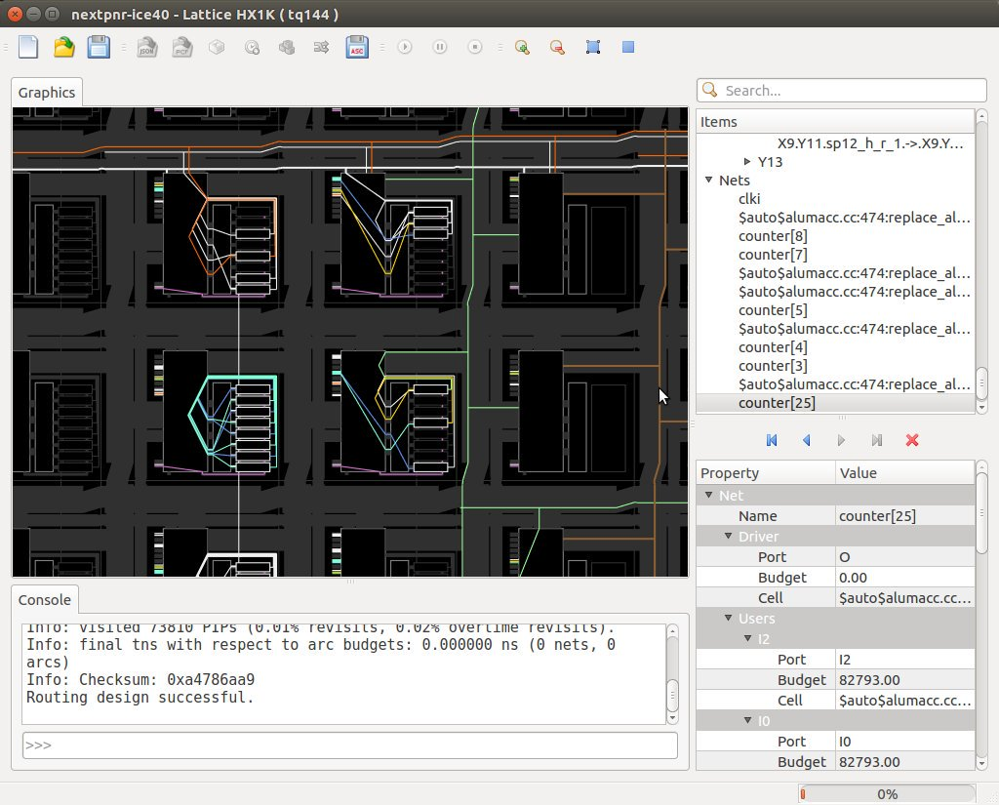
NextPnR
NextPnR aims to be a vendor neutral, timing driven, FOSS FPGA place and route tool.
Currently nextpnr supports:
Lattice iCE40 devices supported by Project IceStorm
Lattice ECP5 devices supported by Project Trellis
A "generic" back-end for user-defined architectures

Slide 16
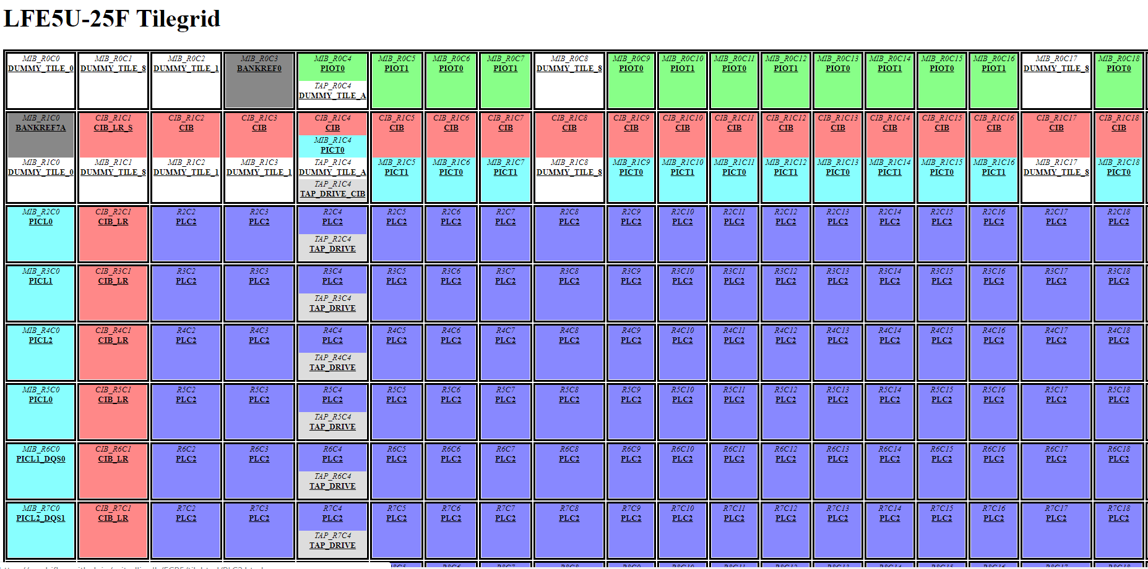
Project Trellis

Slide 17
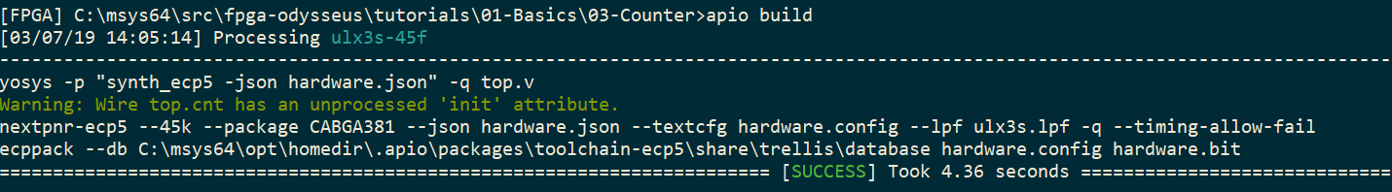
APIO
apio build
apio verify
apio lint
apio sim

Slide 18


HANDS ON WORKSHOP

Slide 19
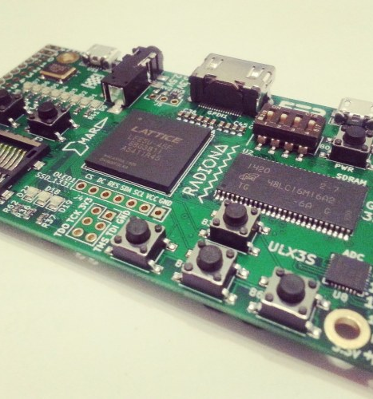
Set up for your board
Enter tutorials folder of fpga-odysseus
apio init –board ulx3s-12f
If board is 1.7 revision :
cp ulx3s_v17patch.lpf ulx3s.lpf
All projects use symbolic links to these files

Slide 20
BASICS

Slide 21
Init
module top ( output wifi_gpio0 );
assign wifi_gpio0 = 1'b1;
endmodule
apio build
apio upload
apio clean

Slide 22
LED
0
0
0
0
0
1
1
1

Slide 23
Button
0
0
0
0
0
0
0
1

Slide 24
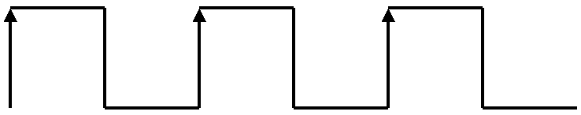
Counter
reg [31:0] cnt = 0;
always @(posedge clk_25mhz)
begin
cnt <= cnt + 1;
end
assign led = cnt[31:24];

Slide 25
Trigger
Button pressed
reg [7:0] cnt = 0;
always @(posedge btn[1])
begin
cnt <= cnt + 1;
end
assign led = cnt;

Slide 26
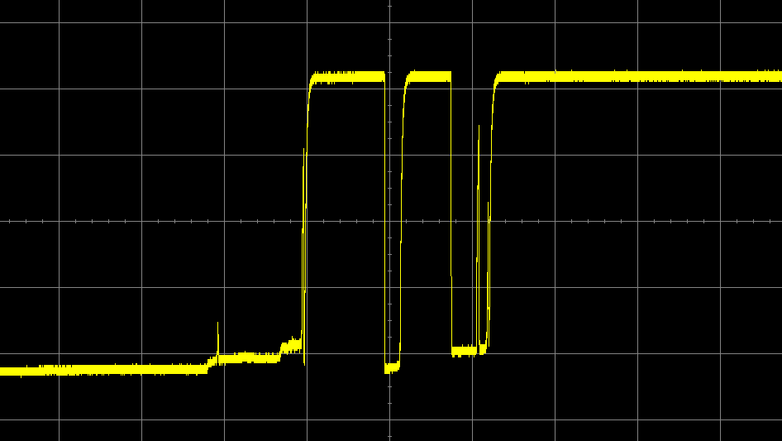
Debounce

Slide 27
AUDIO

Slide 28
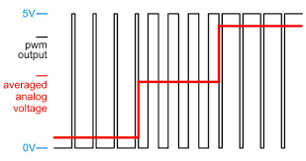
Theory
Digital – Analog Converter
PWM
We will change frequency of change, but keep 50% duty cycle

Slide 29
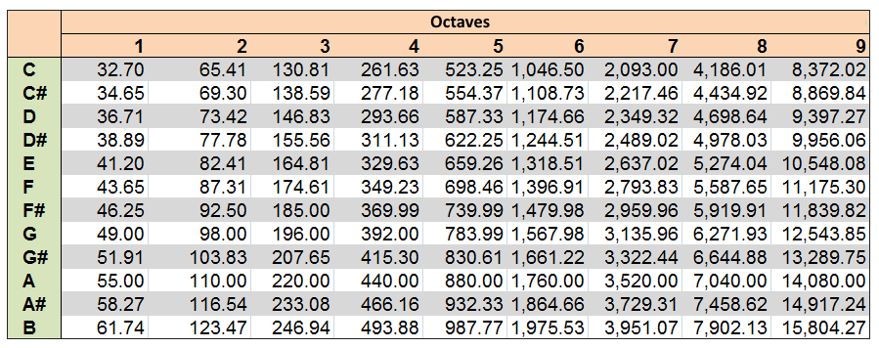
Tone frequency

Slide 30
Siren
parameter TONE_A4 = 25000000/440/2;
parameter TONE_A5 = 25000000/880/2;
always @(posedge clk_25mhz)
if(counter==26'b0)
begin
counter <= (tone[23] ? TONE_A4-1 : TONE_A5-1 );
audio_l <= ~audio_l;
audio_r <= ~audio_r;
end
else
counter <= counter-1;
A4 A4 A4
A5 A5 A5
A4 A4 A4
A5 A5 A5

Slide 31
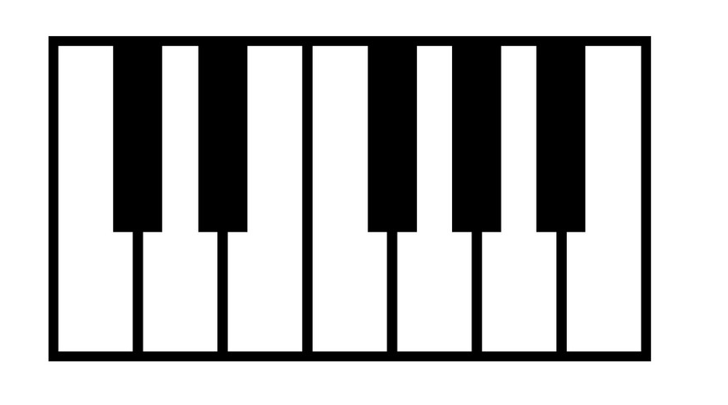
Piano
Button | Frequency
6 | 440 A4
5 | 494 B4
4 | 523 C5
3 | 587 D5
2 | 659 E5
1 | 698 F5

Slide 32
PROTOCOLS

Slide 33
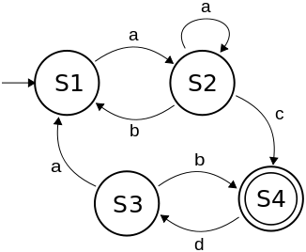
FSM Finite State Machines

Slide 34
Finite State Machines
Mealy Machine | Moore Machine
Output depends both upon the present state and the present input | Output depends only upon the present state.
Generally, it has fewer states than Moore Machine. | Generally, it has more states than Mealy Machine.
The value of the output function is a function of the transitions and the changes, when the input logic on the present state is done. | The value of the output function is a function of the current state and the changes at the clock edges, whenever state changes occur.
Mealy machines react faster to inputs. They generally react in the same clock cycle. | In Moore machines, more logic is required to decode the outputs resulting in more circuit delays. They generally react one clock cycle later.
Taken from www.tutorialspoint.com

Slide 35
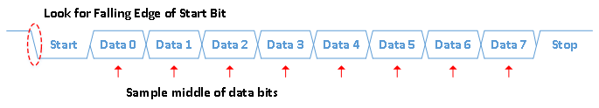
Serial protocol
Image taken from nandland.com

Slide 36
Serial Transmit
data = 8'd65
cfg_divider = 25000000/115200
send_pattern <= {1'b1, data, 1'b0};
send_bitcnt <= 10;
send_divcnt <= 0;
send_pattern <= {1'b1, send_pattern[9:1]};
send_bitcnt <= send_bitcnt - 1;
send_divcnt <= 0;

Slide 37
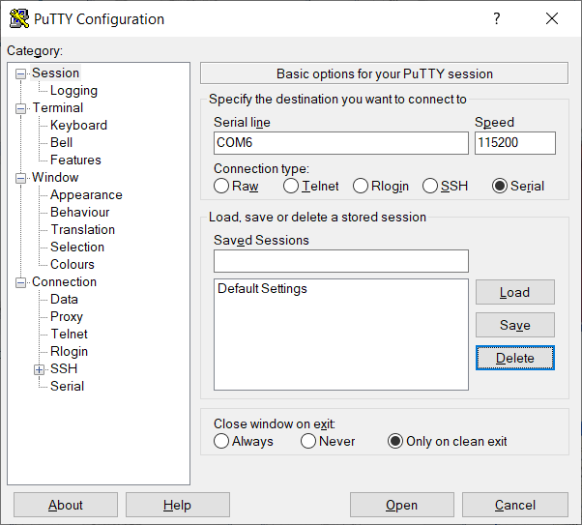
Serial connection
screen /dev/ttyUSB0 115200
Putty or anything similar

Slide 38
Echo
1
0
1
RX
Valid
Data
1
0
1
TX
PC
FPGA

Slide 39
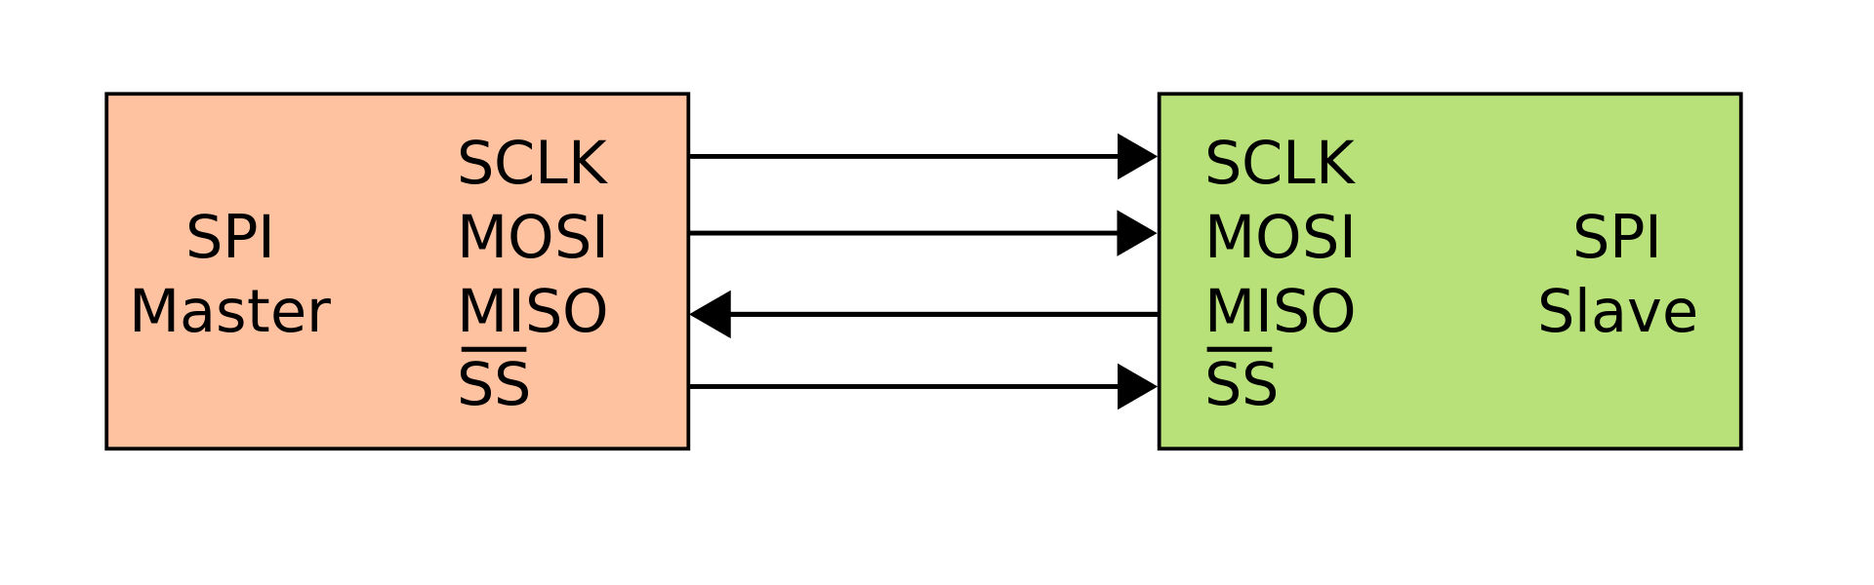
SPI

Slide 40
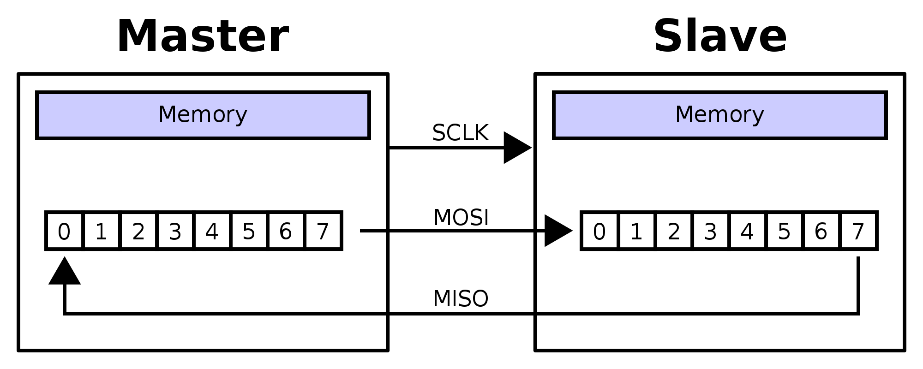
SPI data transfer

Slide 41
VIDEO

Slide 42
SPI Video
Visible area
R | R | R | G | G | G | B | B
64px
96 px

Slide 43
VGA Video
Vertical front porch
Horizontal sync
Horizontal front
porch
Visible area
Horizontal
back
porch
Vertical back porch
Vertical sync

Slide 44
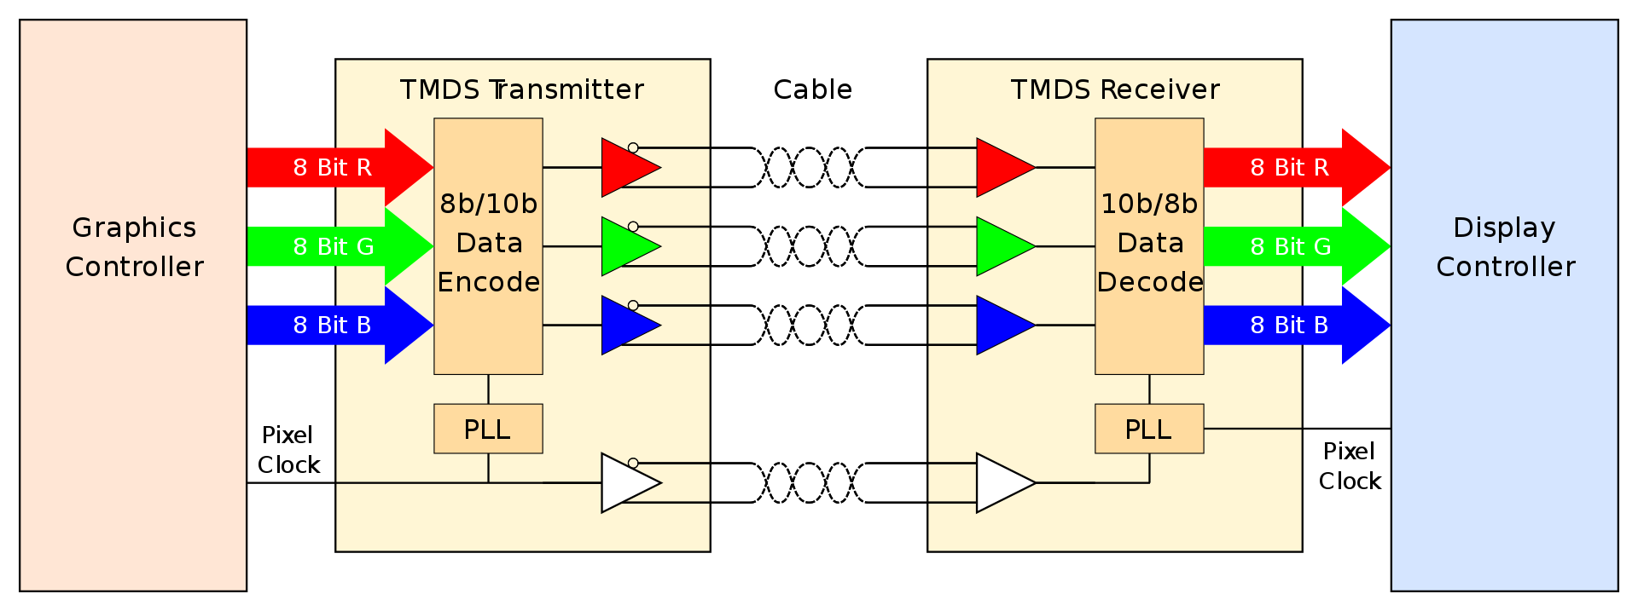
HDMI

Slide 45
Video block
spi_video video(
.clk(clk),
.oled_csn(oled_csn),
.oled_clk(oled_clk),
.oled_mosi(oled_mosi),
.oled_dc(oled_dc),
.oled_resn(oled_resn),
.x(x),
.y(y),
.color(color)
);
hdmi_video hdmi_video
(
.clk_25mhz(clk_25mhz),
.x(x),
.y(y),
.color(color),
.gpdi_dp(gpdi_dp),
.gpdi_dn(gpdi_dn)
);

Slide 46
One color screen
assign color = 8'h02;
assign color = 24’h0000ff;

Slide 47

Checkers
assign color = x[3] ^ y[3] ? 8'hff : 8'h00;
assign color = x[4] ^ y[4] ? 24'hffffff : 24'h000000;

Slide 48
Tricolore
assign color = (x<32) ? 8'h02 : (x<64) ? 8'hff : 8'he0;
assign color = (x<213) ? 24'hff0000 : (x<426) ? 24'hffffff : 24'h0000ff;

Slide 49
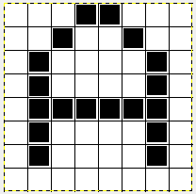
Text

Slide 50
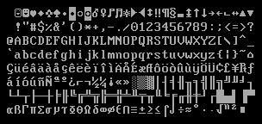
Text buffer
reg [7:0] mem [0:47];
integer k;
initial
begin
for (k = 0; k < 48; k = k + 1)
mem[k] <= 32;
mem[0] <= 8'd65;
mem[1] <= 8'd66;
mem[2] <= 8'd67;
end

Slide 51
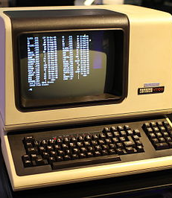
Terminal

Slide 52
PONG

Slide 53

Elements
Score
Ball
Paddle
Display
Net

Slide 54
CPU

Slide 55
Grom - 8
8 bit CPU​
1
4 general purpose registers​
2
12 bit address bus and PC (program counter)​
3
Code and data segment registers (CS,DS) (4 bit)​
4
Stack pointer (SP) (12 bit)​
5
8-bit ALU with C-carry, Z-zero and S-sign flags
6

Slide 56
Instruction set (1/2)
IR |  |  | 2nd | Instruction | Info
0000 | dst | src |  | MOV dst, src
0001 | 00 | reg |  | ADD reg | r0 = r0 + reg
0001 | 01 | reg |  | SUB reg | r0 = r0 - reg
0001 | 10 | reg |  | ADC reg | r0 = r0 + reg + C
0001 | 11 | reg |  | SBC reg | r0 = r0 - reg - C
0010 | 00 | reg |  | AND reg | r0 = r0 and reg
0010 | 01 | reg |  | OR reg | r0 = r0 or reg
0010 | 10 | reg |  | NOT reg | r0 = not reg
0010 | 11 | reg |  | XOR reg | r0 = r0 xor reg
0011 | 00 | reg |  | INC reg | reg = reg + 1
0011 | 01 | reg |  | DEC reg | reg = reg - 1
0011 | 10 | reg |  | CMP reg | flags of r0 - reg
0011 | 11 | reg |  | TST reg | flags of r0 and reg
0100 | 00 | 00 |  | SHL
0100 | 00 | 01 |  | SHR
0100 | 00 | 10 |  | SAL
0100 | 00 | 11 |  | SAR
0100 | 01 | 00 |  | ROL
0100 | 01 | 01 |  | ROR
0100 | 01 | 10 |  | RCL | rotate with carry
0100 | 01 | 11 |  | RCR | rotate with carry
0100 | 10 | reg |  | PUSH reg
0100 | 11 | reg |  | POP reg
0101 | dst | src |  | LOAD dst, [src]
0110 | dst | src |  | STORE [dst], src
0111 | 00 | reg |  | MOV CS, reg
0111 | 01 | reg |  | MOV DS, reg
0111 | 10 | 00 |  | PUSH CS
0111 | 10 | 01 |  | PUSH DS
0111 | 10 | 10 |  | ???
0111 | 10 | 11 |  | ???
0111 | 11 | 00 |  | ???
0111 | 11 | 01 |  | ???
0111 | 11 | 10 |  | RET
0111 | 11 | 11 |  | HLT

Slide 57
Instruction set (2/2)
1000 | 00 | 00 | val | JMP val | (unconditionally jump)
1000 | 00 | 01 | val | JC val | (carry=1 jump)
1000 | 00 | 10 | val | JNC val | (carry=0 jump)
1000 | 00 | 11 | val | JM val | (sign=1 jump)
1000 | 01 | 00 | val | JP val | (sign=0 jump)
1000 | 01 | 01 | val | JZ val | (zero=1 jump)
1000 | 01 | 10 | val | JNZ val | (zero=0 jump)
1000 | 01 | 11 | val | ???
1000 | 10 | 00 | val | JR val | (unconditionally jump)
1000 | 10 | 01 | val | JRC val | (carry=1 jump)
1000 | 10 | 10 | val | JRNC val | (carry=0 jump)
1000 | 10 | 11 | val | JRM val | (sign=1 jump)
1000 | 11 | 00 | val | JRP val | (sign=0 jump)
1000 | 11 | 01 | val | JRZ val | (zero=1 jump)
1000 | 11 | 10 | val | JRNZ val | (zero=0 jump)
1000 | 11 | 11 | val | ???
1001 | high |  | low | JUMP addr
1010 | high |  | low | CALL addr
1011 | high |  | low | MOV SP,addr
1100 | xx | reg | val | IN reg,[val]
1101 | xx | reg | val | OUT [val],reg
1110 | xx | 00 | val | MOV CS,val
1110 | xx | 01 | val | MOV DS,val
1110 | xx | 10 | val | ???
1110 | xx | 11 | val | ???
1111 | 00 | reg | val | MOV reg, val
1111 | 01 | reg | val | LOAD reg, [val]
1111 | 10 | reg | val | STORE [val], reg
1111 | 11 | xx |  | ???

Slide 58
ALU
ALU_OP_ADD :
tmp = A + B;
ALU_OP_SUB :
tmp = A - B;
ALU_OP_ADC :
tmp = A + B + { 7'b0000000, CF };
ALU_OP_SBC :
tmp = A - B - { 7'b0000000, CF };
ALU_OP_AND :
tmp = {1'b0, A & B };
ALU_OP_OR :
tmp = {1'b0, A | B };
ALU_OP_NOT :
tmp = {1'b0, ~B };
ALU_OP_XOR :
tmp = {1'b0, A ^ B};
ALU_OP_SHL :
tmp = { A[7], A[6:0], 1'b0};
ALU_OP_SHR :
tmp = { A[0], 1'b0, A[7:1]};
ALU_OP_SAL :
// Same as SHL
tmp = { A[7], A[6:0], 1'b0};
ALU_OP_SAR :
tmp = { A[0], A[7], A[7:1]};
ALU_OP_ROL :
tmp = { A[7], A[6:0], A[7]};
ALU_OP_ROR :
tmp = { A[0], A[0], A[7:1]};
ALU_OP_RCL :
tmp = { A[7], A[6:0], CF};
ALU_OP_RCR :
tmp = { A[0], CF, A[7:1]};

Slide 59
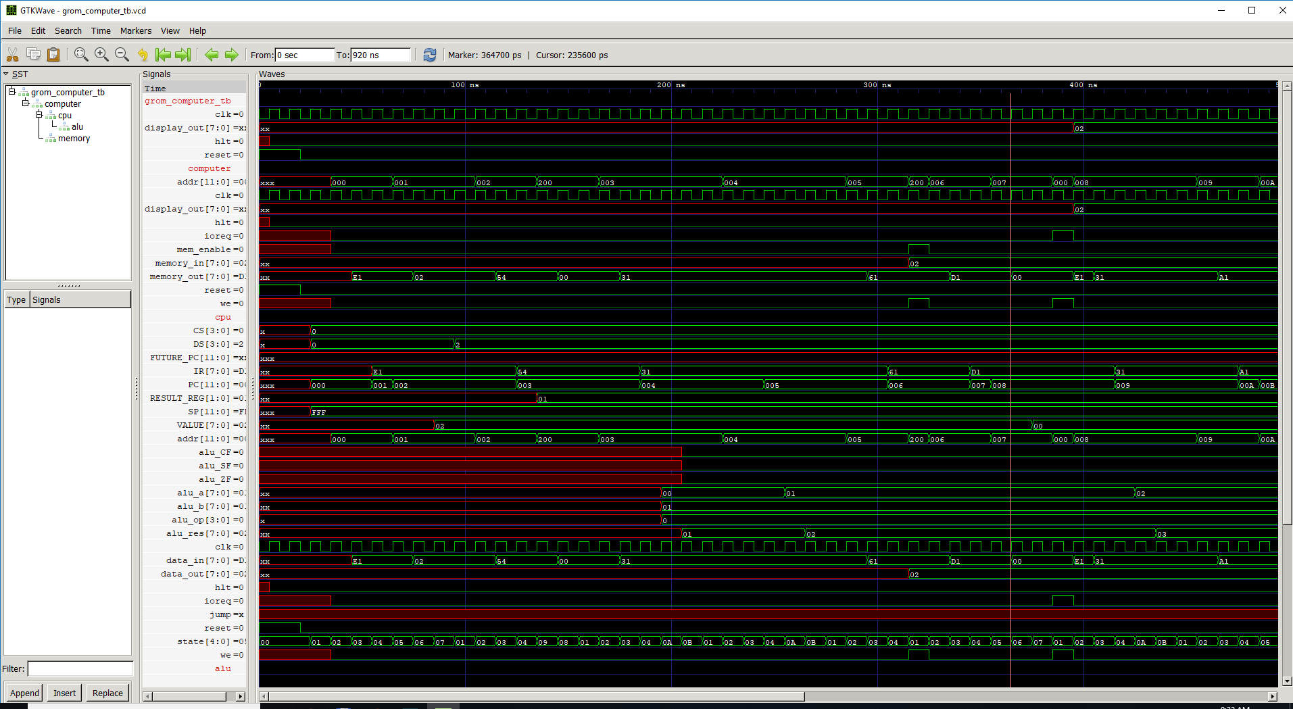

Slide 60
Software running on our CPU
store[0] <= 8'b11100001; // MOV DS,2
store[1] <= 8'b00000010; //
store[2] <= 8'b01010100; // LOAD R1,[R0]
store[3] <= 8'b00110001; // INC R1
store[4] <= 8'b00110001; // INC R1
store[5] <= 8'b01100001; // STORE [R0],R1
store[6] <= 8'b11010001; // OUT [0],R1
store[7] <= 8'b00000000; //
store[8] <= 8'b00110001; // INC R1
store[9] <= 8'b10100001; // CALL 0x100
store[10] <= 8'b00000000; //
store[11] <= 8'b01111111; // HLT
store[256] <= 8'b11010001; // OUT [0],R1
store[257] <= 8'b00000000; //
store[258] <= 8'b01111110; // RET

Slide 61
COMPUTER

Slide 62
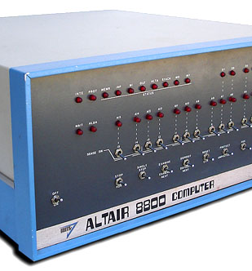
Altair
M – Memory examine and change
D – Dump memory
J – Jump to user program
J000000

Slide 63
RISC-V

Slide 64

Risc-V ISA
RV32I - Base Integer Instruction Set, 32-bit
RV64I - Base Integer Instruction Set, 64-bit
M - Standard Extension for Integer Multiplication and Division
C - Standard Extension for Compressed Instructions
A - Standard Extension for Atomic Instructions
F - Standard Extension for Single-Precision Floating-Point
D - Standard Extension for Double-Precision Floating-Point
Q - Standard Extension for Quad-Precision Floating-Point

Slide 65
AttoSoC
Serial
PicoRV32
Memory
LEDs

Slide 66
Building
make (to create firmware.hex)
apio build
apio upload
After change of files :
make clean
apio clean

